Slide 1
Poster Templates
These slides have been sized to create a poster 48” wide by 36” high. If you want to change the size, click Design at the top, then page setup – change width and height to the size you need.
You many include one of the MCN Logos – the preferred logo is the one with the seal on the left side. Do not distort the logo – you may make it larger or smaller, but click on the corner of the text box to change the size.
For information about the University Graphics Standards, visit http://advancement.illinoisstate.edu/downloads/identity/ISU_GraphicStandards.pdf
For information about the University Editorial Standards, visit http://advancement.illinoisstate.edu/downloads/identity/ISU_EditorialStandards.pdf
The Graduate School’s Web site has helpful information for creating posters: http://www.grad.ilstu.edu/symposium/ (click guidelines)
The slides below have the MCN logos, images, and some SAMPLE backgrounds – this is just to give ideas about format and layout.

Slide 2

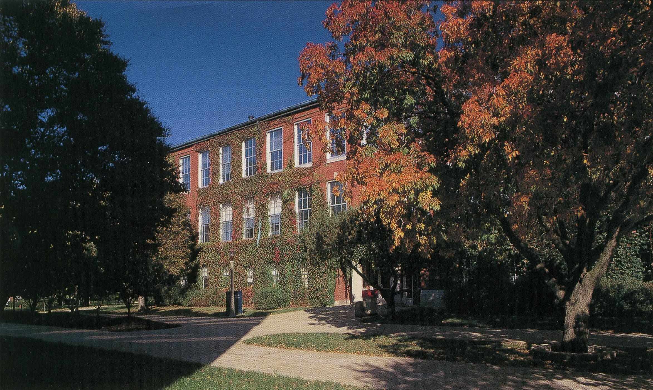

ISU/MCN Images and Logos

Slide 3
This heading is in Arial font set at 100 point
Header
Text sample
Header
Text sample
Photo
Header
Text sample
Header
Text sample

Slide 4
This heading is in
Time New Roman font set at 150 point
Photo
Header
Text sample
Header
Text sample
Header
Text sample
Header
Text sample

Slide 5
This heading is in Verdana font set at 100 point
Header/Photo
Text sample
Header/Photo
Text sample
Header/Photo
Text sample
Header/Photo
Text sample
Header/Photo
Text sample
Header/Photo
Text sample

Slide 6
Header
Text sample
Header
Text sample
Photo
Header
Text sample
Header
Text sample
This text is in Times New Roman font set at 80 point

Slide 7
This heading is in Arial font set at 100 point
Text
Text
Text

Slide 8

Text
Text
Text

